Slide 2
Prediction of Customer Churn
Presented by
Vijay Kumar Bollina
Santhosh Reddy Mallikireddy
Mallikarjun Sasnur
Vamsi Krishna Darapaneni

Slide 3

Outline
Business Problem
Why Customer Churn?
Approaches
Predictions
Conclusion

Slide 4

Business Problem
Losing customers to competitions is a big pain.
It is more expensive to acquire new customers than to retain existing ones.
It impacts on the lifetime value of the customer because it affects
Length of service
Future revenue of company

Slide 5

Why Customer Churn?
Price
Service Quality
Lack of Customer Service
Billing Disputes
New Competitor entering Market
New Promotional offers or technology by competitor

Slide 6

Approaches
There are two types of approaches that can be implemented to reduce churn rate:
Untargeted Marketing like
Producing superior products
Mass Advertising
Targeted Marketing like Identify customers who are likely to churn based on historical data and encourage them to stay by providing suitable promotional offers

Slide 7

Prediction 1
From our data predictions of 1000 customers,
954 customers are not likely to churn
46 customers are likely to churn
Best strategy would be to consider targeted marketing for those 46 customers who are likely to churn.

Slide 8
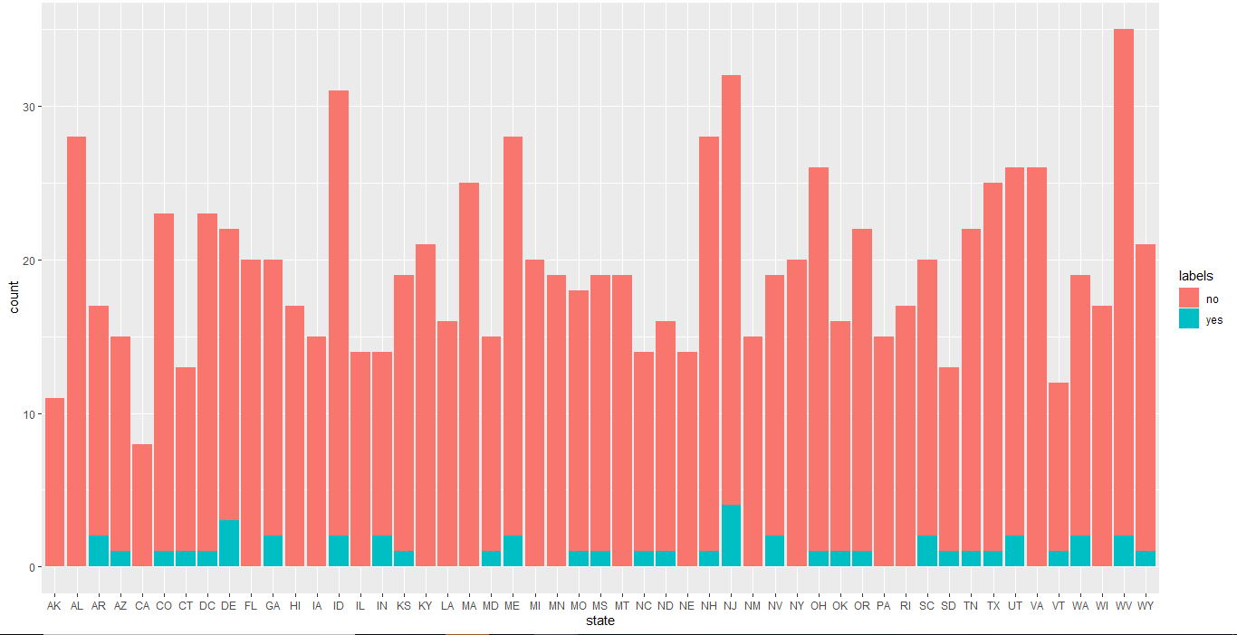
Prediction 2
From the above graph we can see that customers from some states are likely to churn. So, we can do targeted marketing to these states to decrease the churn rate.

Slide 9

Conclusion
So, the best way to reduce churn is by
Staying in sync with customers
Implementing new or better technologies than competitions.
To take actions on customer feedbacks and worries as soon as possible.

Slide 10
Thank You.
www.kent.edu

